Slide 1
USB Mode for Room Series
Using Third-Party Capture Devices v1.3
Enrico Conedera
Senior Technical Marketing Engineer
March 11, 2021

Slide 2
Goals
Enable Room Kits and Room Series with USB Passthrough
Document several tested solutions
Make the user experience simple

Slide 3
USB Passthrough enables the entire video conferencing system to be used with any PC application for conferencing. * Screens * Cameras * Microphones * Sound system

Slide 4
Solution Summary

Slide 5
Install a USB Capture Device into the System
Connect audio and video signals from the Room Kit
Follow provided detailed system line drawings
Connect laptop using standard HDMI cable for presentation, and one USB cable
Import and run macros to automate the system
See detailed instructions starting on slide 20

Slide 6
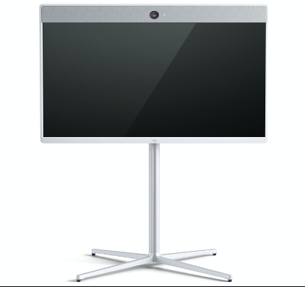
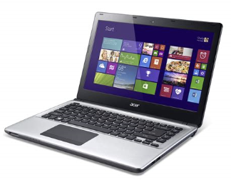
Basic Design
You start with a laptop computer, a video conference system, and a third-party USB capture device.
Room 55 (or Room Kit, Kit Plus, Room 70, SX80, MX700/800)
USB Capture Device

Slide 7
Basic Design
You add a standard HDMI cable, just as if you were going to give a presentation.
Room 55 (or Room Kit, Kit Plus, Room 70, SX80, MX700/800)
Presentation video and audio
HDMI
USB Capture Device
You make sure that sound works by playing some music. Be sure you can hear it in the video system loudspeakers.
You may need to adjust your laptop settings.

Slide 8
Basic Design
Now add in the other wires. Start with a monitor output from the video system.
Room 55 (or Room Kit, Kit Plus, Room 70, SX80, MX700/800)
Presentation video and audio
HDMI
Monitor out
USB Capture Device
This gets connected to the HDMI input on the capture device.

Slide 9
Basic Design
Then, using the provided system drawings, add an audio line from the codec line output.
Room 55 (or Room Kit, Kit Plus, Room 70, SX80, MX700/800)
Presentation video and audio
HDMI
Monitor out
Line output
USB Capture Device
This is required for all endpoints except the Room Kit Pro and Room 70 G2. They don’t need the audio cable.

Slide 10
Basic Design
Lastly, add a USB cable from the laptop to the capture device.
Room 55 (or Room Kit, Kit Plus, Room 70, SX80, MX700/800)
Presentation video and audio
HDMI
USB
Monitor out
Line output
USB Capture Device
Use the correct USB cable – some capture devices require USB 3. The device will include the proper cable.

Slide 11
Now things get interesting…

Slide 12
Basic Design
The HDMI cable actually provides conference video and audio from your laptop to the video system.
Room 55 (or Room Kit, Kit Plus, Room 70, SX80, MX700/800)
Presentation video and audio
Conference video and audio
HDMI
USB
Monitor out
Line output
USB Capture Device

Slide 13
Basic Design
The HDMI cable actually provides conference video and audio from your laptop to the video system.
Room 55 (or Room Kit, Kit Plus, Room 70, SX80, MX700/800)
Presentation video and audio
Conference video and audio
HDMI
USB
Monitor out
Camera(s)
Microphone audio
USB Capture Device
Line output
The HDMI and audio wires from the video system provide all of the cameras (using SelfView) and all of the microphones.

Slide 14
Basic Design
The HDMI cable actually provides conference video and audio from your laptop to the video system.
Room 55 (or Room Kit, Kit Plus, Room 70, SX80, MX700/800)
Presentation video and audio
Conference video and audio
HDMI
USB
Monitor out
Camera(s)
Microphone audio
USB Capture Device
Line output
And the USB cable makes the laptop think that the codec is a giant USB camera and microphone.
The HDMI and audio wires from the video system provide all of the cameras (using SelfView) and all of the microphones.

Slide 15
Summary – Basic Design

Slide 16
Summary - Basic Design
Room 55 (or Room Kit, Kit Plus, Room 70, SX80, MX700/800)
Conference video and audio
HDMI
USB
Camera(s)
There are only two connections to the laptop – the usual HDMI cable for presentation and one USB cable.
Microphone audio
USB Capture Device
The Room Kit provides its camera feed and its microphone feed. All cameras and microphones work normally.
The USB cable connects the cameras and microphones to the laptop.

Slide 17
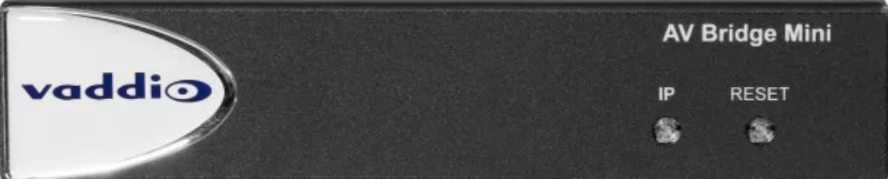
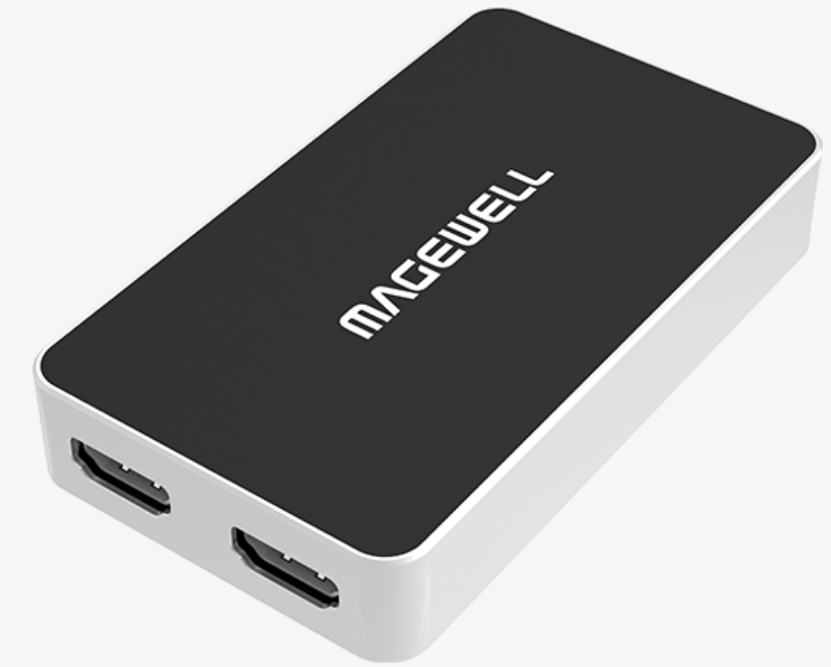
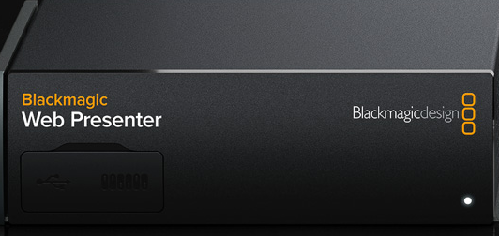
Tested USB Capture Devices
Vaddio AV Bridge Mini
Magewell USB Capture HDMI Plus
Blackmagic Web Presenter
No longer available. Do not use the new “HD” version.

Slide 18
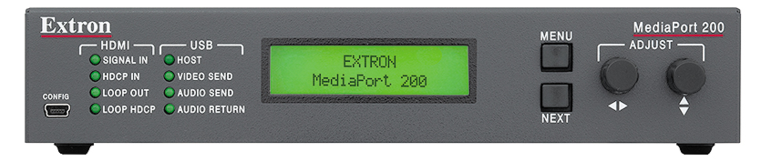
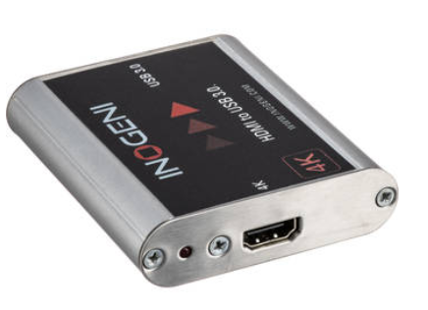
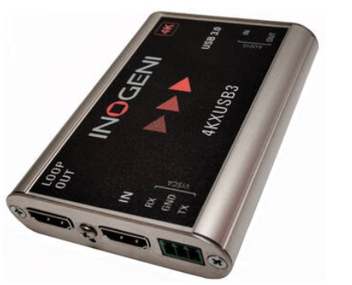
Tested USB Capture Devices
Extron MediaPort 200
Inogeni 4K2USB3 for Pro platform
Inogeni 4KXUSB3 for Room Kit platform

Slide 19
To Use USB Mode:
Hook up laptop using just two cables: HDMI for presentation and USB
Press the Enable USB mode button on the Touch 10
Configure your conferencing software to use USB camera and microphone
Start your meeting normally

Slide 20
Detailed Installation Instructions

Slide 21
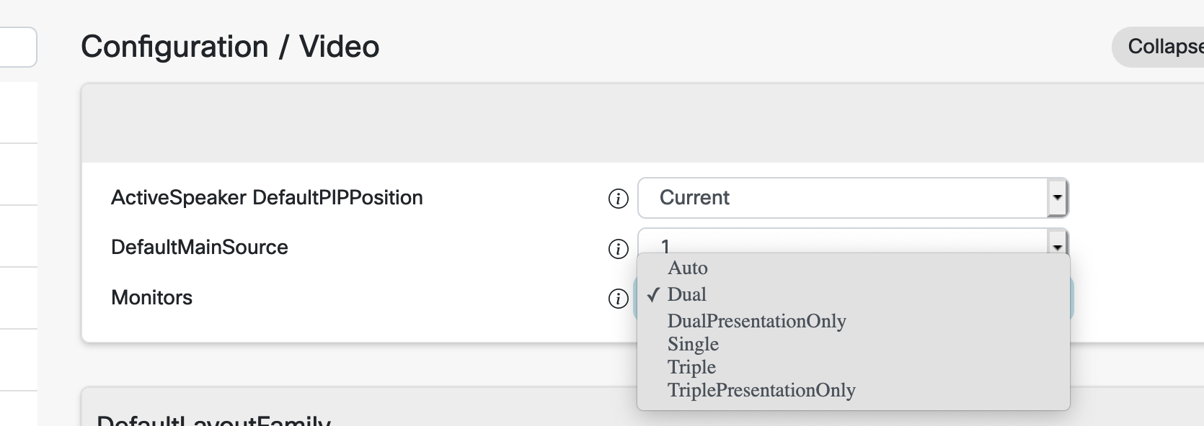
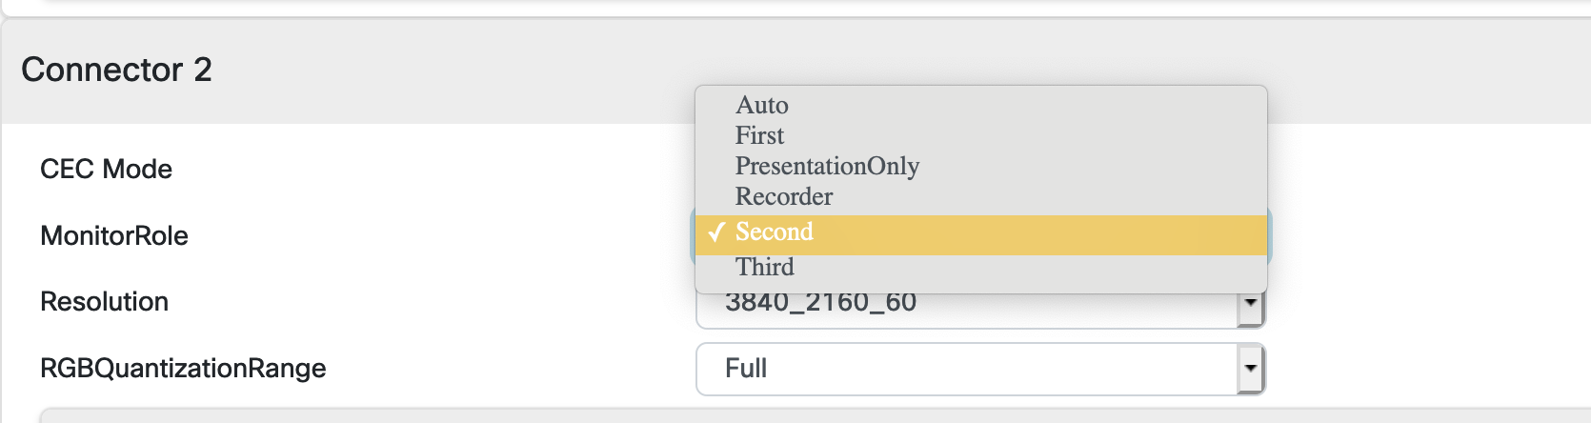
Detailed Installation Instructions Use the codec web interface
First, manually configure the number of screens for normal use (without the USB Capture device attached. Do not choose “Auto”)
This is all in the “Video” section. |
If you need any special monitor behaviors, configure them now.
PresentationOnly or Recorder | are not uncommon |

Slide 22
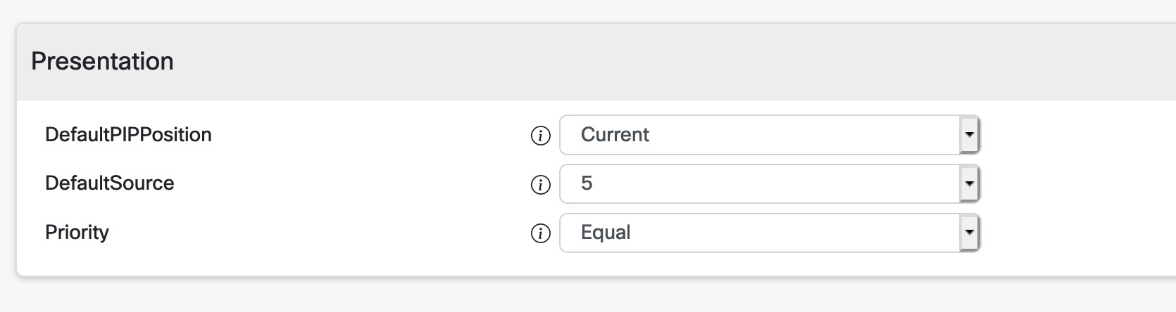
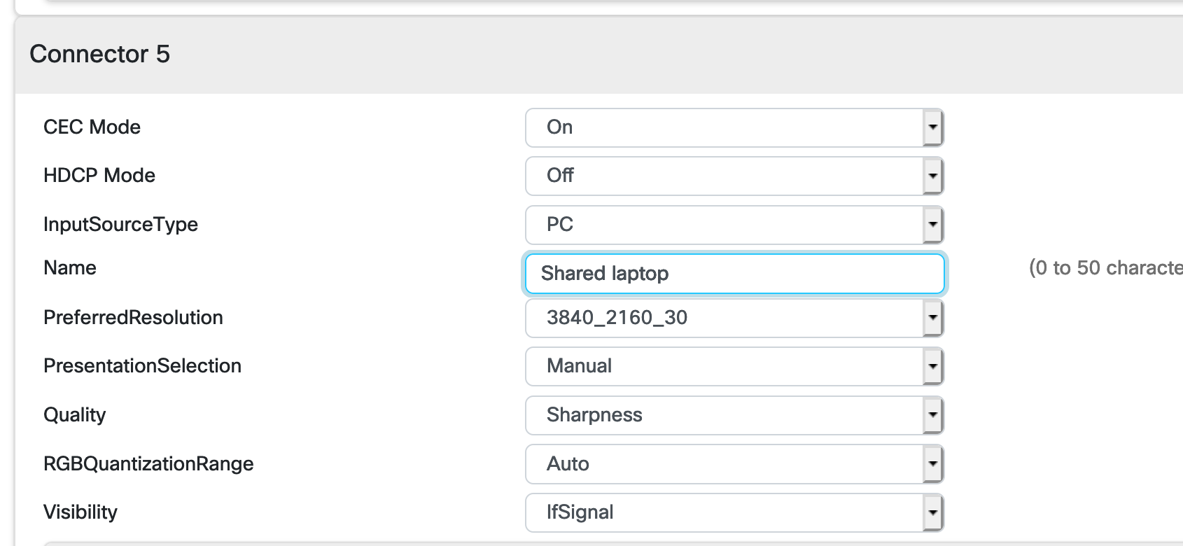
Detailed Installation Instructions Use the codec web interface
Decide which HDMI input you will use for the “Shared Laptop”
This is Important. Set the | DefaultSource to be the | connector number you are using. |
Rename this input to something user-friendly
Remember, this name will | be used on the Touch 10. |

Slide 23
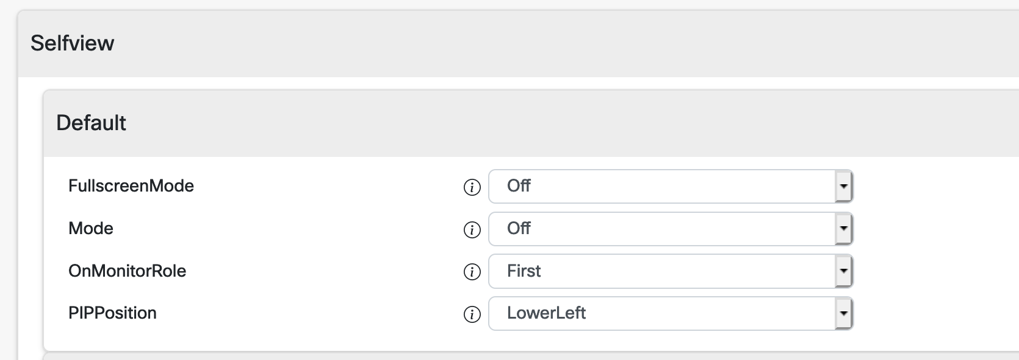
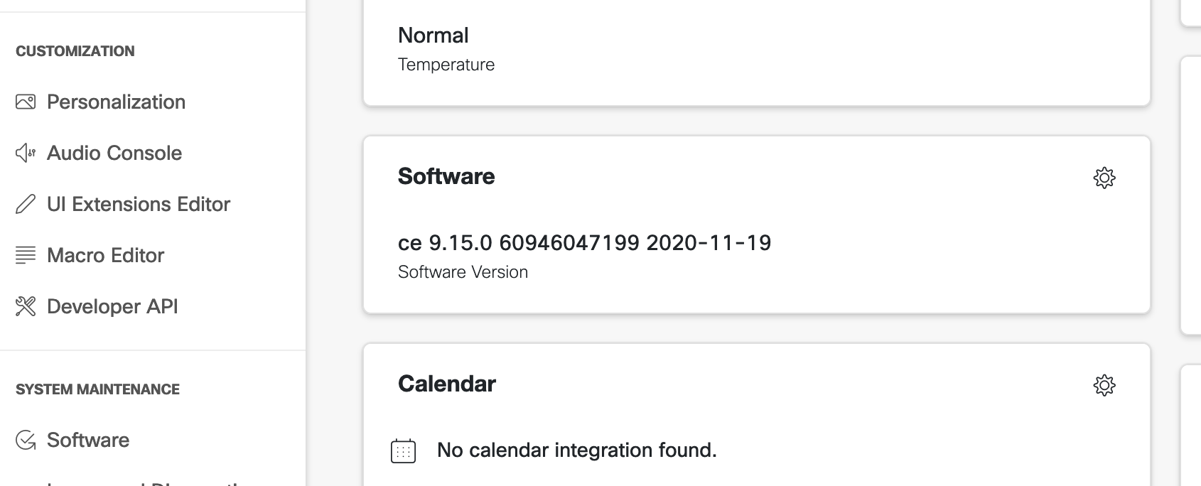
Detailed Installation Instructions Use the codec web interface
Configure your system for its normal SelfView defaults.
Whenever you turn on SelfView, it will | default to these positions. |
If not cloud-registered, make sure your system is running CE9.14 or higher.
Upgrade if necessary |

Slide 24
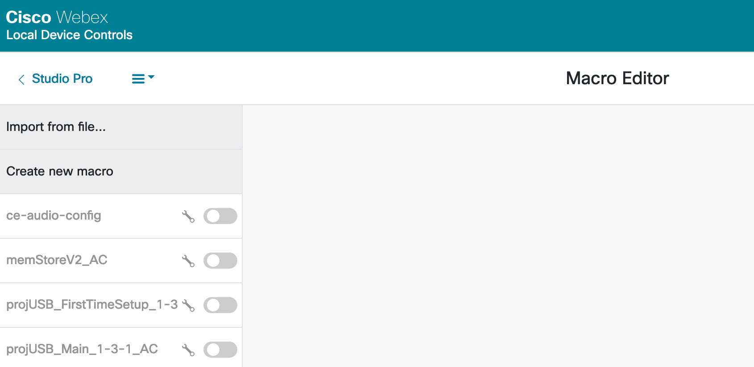
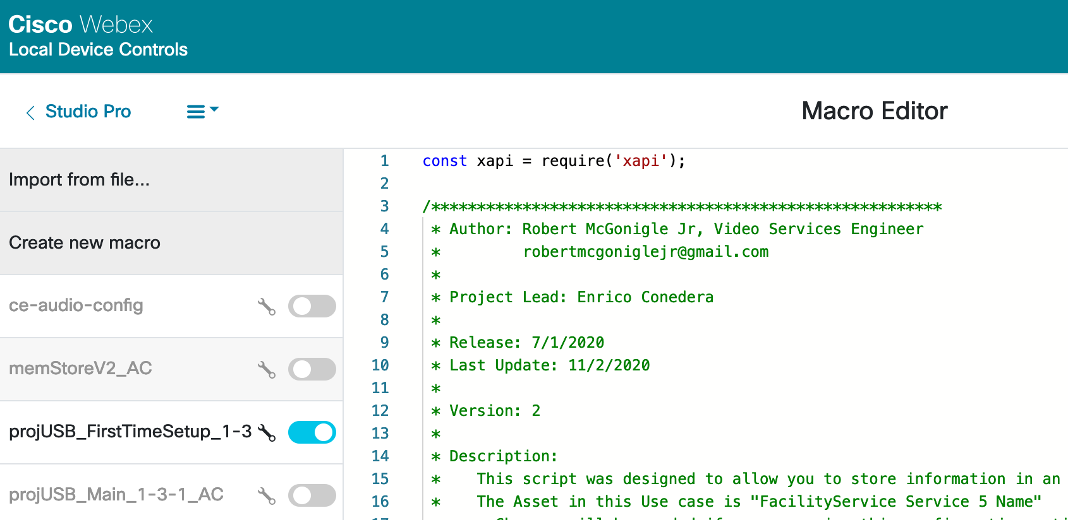
Macro Installation Use the codec web interface
Load in all 3 CE Macros into the endpoint and save them.
Use ‘Import from file…’ | then save them to the system. |
Turn on only the script projUSB_FirstTimeSetup_1-3-<x>
Wait while the macros | configure themselves |

Slide 25
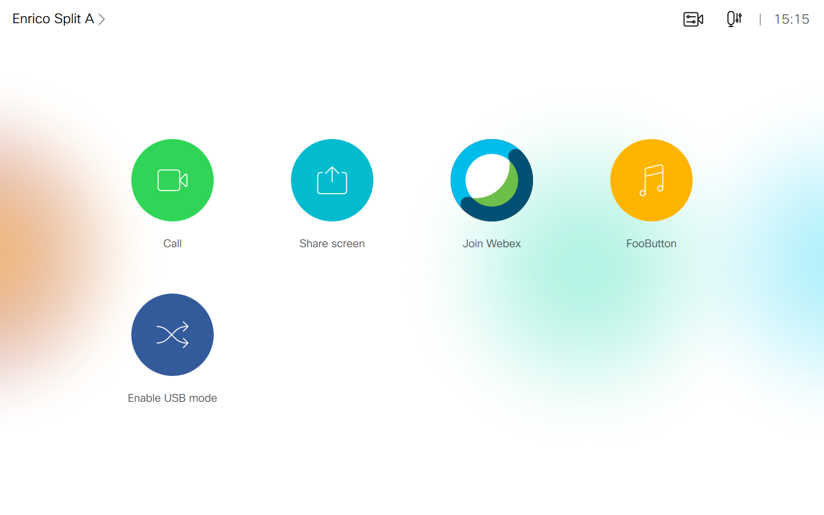
Ready to Use “Enable USB Mode” button is there
And so are any custom buttons

Slide 26
Important - set up the laptop
Use an HDMI cable from the laptop, just as if you were going to give a presentation.
Mirror your laptop screen so you see the same thing on the big screen.
Share your laptop locally and make sure sound works by playing some music.
Next, hook up the USB cable from the capture device to your laptop.
There are no more physical connections needed – just those two wires.

Slide 27
Important - set up your software client
Start Microsoft Teams, Zoom, BlueJeans, or whichever Internet client you are using.
Find the settings area and choose a USB microphone and USB camera that corresponds to the name of your capture device.
Do not choose USB speakers. Instead, go to your computer preferences or Control Panel and make sure sound is set to use ‘Room Kit’ or ‘Room 55’, which means that your HDMI cable will pass sound correctly.
This is actually the most difficult part – to train your users how to setup their laptop.

Slide 28
Now, finally, you can select Enable USB Mode on the Touch 10
…and enjoy all of your cameras, microphones, screens, and sound system

Slide 29
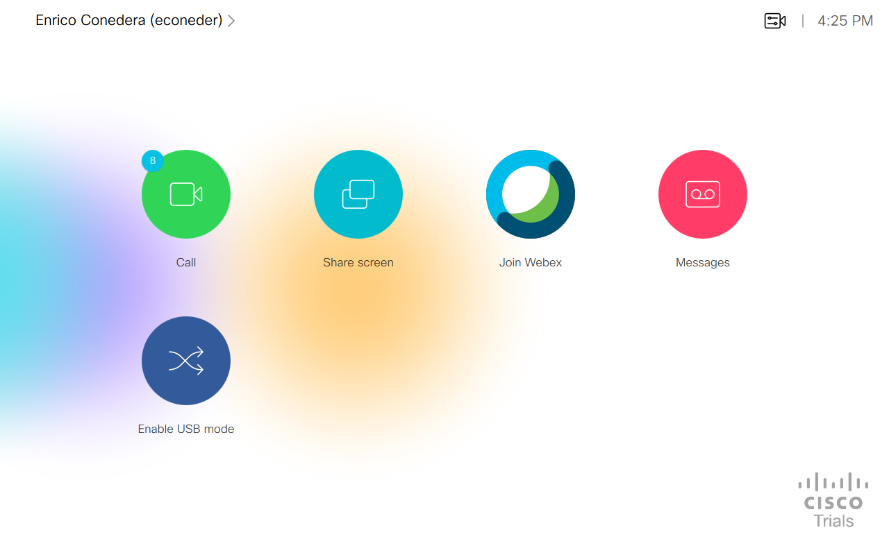
The USB button on the Touch 10

Slide 30
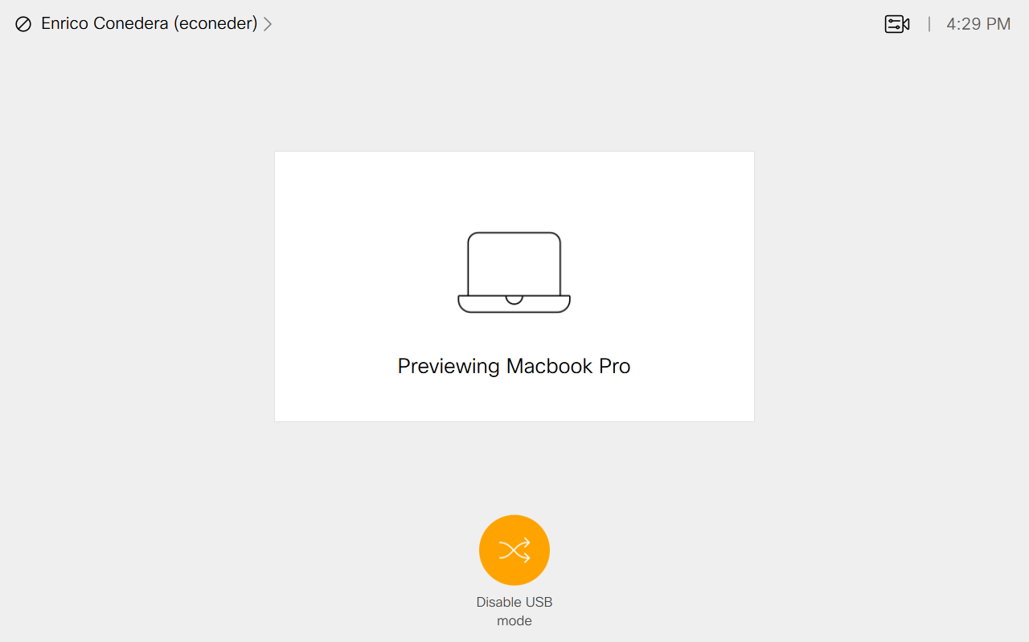
Camera control available
Do Not Disturb activated
While in USB Mode…

Slide 31
Important Points
All installed cameras can be used normally
SpeakerTrack and PresenterTrack included
All installed microphones can be used normally
Including wireless or third-party microphone systems
You can mute from the Touch 10 or the Cisco Table Microphone
Endpoint settings are saved, and restored automatically after exiting USB mode

Slide 32
Which conferencing software applications can be used?
Microsoft Teams
Zoom
Google Meet
BlueJeans
FaceTime
…any software that allows choosing a USB camera and microphone

Slide 33
Which video conference endpoints can be used?
Room Kit
Room Kit Plus
Room Kit Pro
Room 55
Room 55 Dual
Room 70 Single or Dual
SX80, MX700 and MX800
The Room Kit Mini and Desk Pro already have USB passthrough

Slide 34
FAQs
What is USB passthrough?
It allows you to use your video conference endpoint when using computer conferencing software: screens, cameras, microphones, and loudspeakers
Can I buy the solution from Cisco?
No. These are third-party devices
The Cisco TAC cannot assist
Can I install it myself?
An AV professional needs to do the installation

Slide 35
FAQs
Where can I get the system drawings for installation?
In a public Cisco Teams space or from a colleague
Where can I get the macro?
In a public Cisco Teams space or from a colleague
Thanks to Bobby McGonigle for writing the macro

Slide 36
Tips
Practice using USB camera and mic before your meeting
The hardest part about all of this is understanding how your software client allows use of USB devices
Do not choose “USB speakers”
Use HDMI audio from your laptop
Be careful about muting yourself
Use either the Room Kit mute buttons, or the software client, but not both

